Slide 1


Slide 2


Topic – 3 Regular Expressions in R
Text Analytics
Notes:
Do we know the topic number for this?

Slide 3

INDEX
What is a regular expression?
Various Regular expressions in R
Notes:
Source of information : Reviews from various websites through google search
From this source, we extracted the “dimensions” of the data – which is nothing but the words in the reviews.This adds some implicit structure to the otherwise unstructured data we’re dealing with.
The goal is to identify which are the best books to read.

Slide 4
What is a regular expression?
A ‘regular expression’ is a flexible tool for finding and replacing text
They can be easily applied globally across a document, dataset or specifically to individual strings
Regular expression were developed for the language of Perl (http://www.perl.org/) and have been since then implemented in various other programming languages due to their nice functionalities

Slide 5
INDEX
What is a regular expression?
Various Regular expressions in R
Notes:
Source of information : Reviews from various websites through google search
From this source, we extracted the “dimensions” of the data – which is nothing but the words in the reviews.This adds some implicit structure to the otherwise unstructured data we’re dealing with.
The goal is to identify which are the best books to read.

Slide 6
Regular expressions in R
grep
grepl
regexpr
gregexpr
sub
gsub

Slide 7
Regular expressions in R
grep, grepl, regexpr and gregexpr search for matches to argument pattern within each element of a character vector
sub and gsub perform replacement of the first and all matches respectively
Notes:
Source of information : Reviews from various websites through google search
From this source, we extracted the “dimensions” of the data – which is nothing but the words in the reviews.This adds some implicit structure to the otherwise unstructured data we’re dealing with.
The goal is to identify which are the best books to read.

Slide 8
Regular expressions in R
grep
grepl
regexpr
gregexpr
sub
gsub

Slide 9
grep
grep(pattern, x)
searches for a specified substring pattern in a vector x of strings
It outputs the position
You can use regex’s in the pattern
Notes:
This reports that elements 1 and 2 of "Harry Potter","Game of thrones","Lord of the rings")—that is, "Harry Potter“ and "Game of thrones"—contain either an a or a u.

Slide 10
Regular expressions in R
grep
grepl
regexpr
gregexpr
sub
gsub

Slide 11

grepl
grepl(pattern, x)
Similar to grep
It outputs a logical value
You can use regex’s in the pattern
Notes:
This reports that elements 1 and 2 of "Harry Potter","Game of thrones","Lord of the rings")—that is, "Harry Potter“ and "Game of thrones"—contain either an a or a u.

Slide 12
Regular expressions in R
grep
grepl
regexpr
gregexpr
sub
gsub

Slide 13
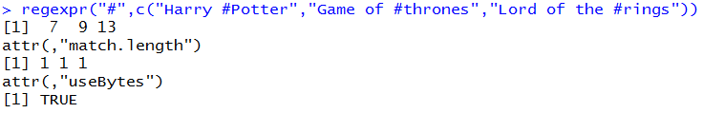
regexpr
regexpr(pattern, x)
finds the character position of the first instance of pattern within text
Notes:
This reports that elements 1 and 2 of "Harry Potter","Game of thrones","Lord of the rings")—that is, "Harry Potter“ and "Game of thrones"—contain either an a or a u.

Slide 14
Regular expressions in R
grep
grepl
regexpr
gregexpr
sub
gsub

Slide 15
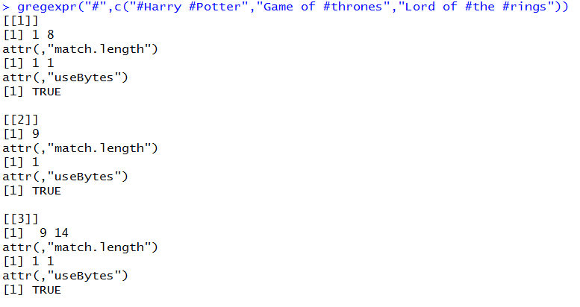
gregexpr
gregexpr(pattern, x)
finds the character position for all instances of pattern within text
Notes:
This reports that elements 1 and 2 of "Harry Potter","Game of thrones","Lord of the rings")—that is, "Harry Potter“ and "Game of thrones"—contain either an a or a u.

Slide 16
Regular expressions in R
grep
grepl
regexpr
gregexpr
sub
gsub

Slide 17
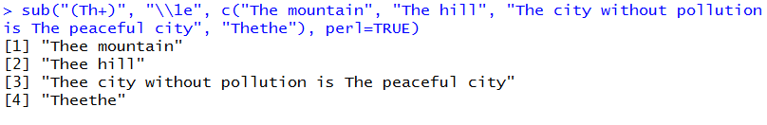
sub
sub(pattern, replacement)
It replaces a given string with another string
Only the first match in each string element is replaced.
If no matches could be found in some strings, those are copied into the result vector unchanged.
Notes:
This reports that elements 1 and 2 of "Harry Potter","Game of thrones","Lord of the rings")—that is, "Harry Potter“ and "Game of thrones"—contain either an a or a u.

Slide 18
Regular expressions in R
grep
grepl
regexpr
gregexpr
sub
gsub

Slide 19
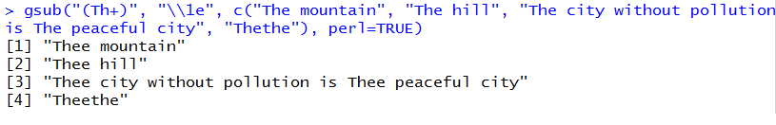
gsub
Gsub(pattern,replacement)
It replaces a given string with another string
All the matches in each string element is replaced
Notes:
This reports that elements 1 and 2 of "Harry Potter","Game of thrones","Lord of the rings")—that is, "Harry Potter“ and "Game of thrones"—contain either an a or a u.

Slide 20
RECAP
Notes:
Closing Audio to be recorded
Under this topic we have discussed in detail about
…..
That’s it for this topic.
For any queries, do email us at info@jigsawacademy.com
Thanks!

Slide 21
THANK YOU

